Slide 1


Streamlining Software Development: An Introduction to DevOps

Slide 2


Streamlining Software Development: An Introduction to DevOps
Reynaldo III
Software Engineer

Slide 3
Streamlining Software Development: An Introduction to DevOps

Slide 4

Streamlining Software Development: An Introduction to DevOps
What is DevOps?
Cultural philosophies
Practices
Tools
Notes:
What is DevOps? Does anyone in here have an idea what is devops? I think wala pa kay wa pa gina practice ninyo karon. more on coding rajud mo diba?
so DevOps is the combination of cultural philosophies, practices, and tools.
NEXT

Slide 5

Streamlining Software Development: An Introduction to DevOps
What is DevOps?
Cultural philosophies
Practices
Tools
Notes:
that increases an organization’s ability to deliver applications and services at high velocity.
NEXT

Slide 6
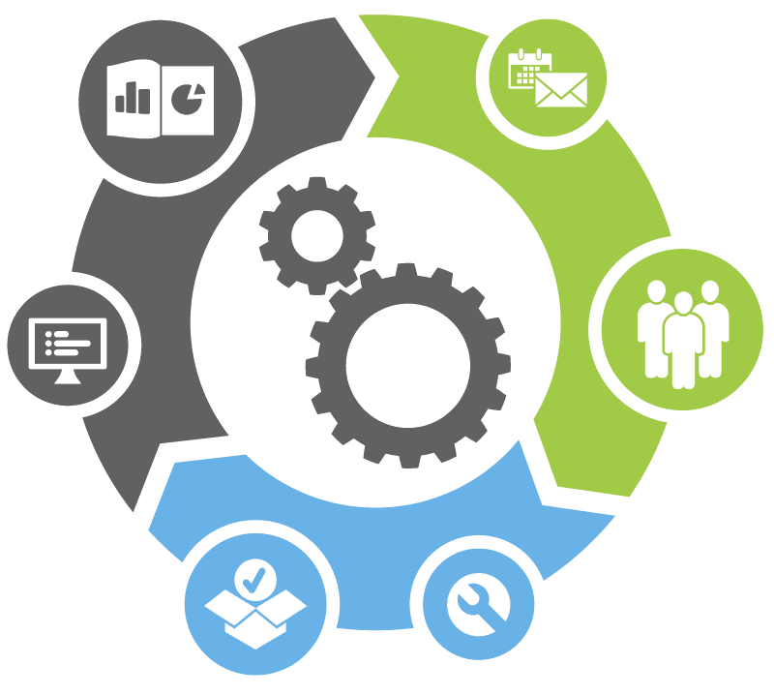
Streamlining Software Development: An Introduction to DevOps
What is DevOps?
Cultural philosophies
Practices
Tools
Notes:
in short, its main goal is to deploy quality projects to the client to the soonest as possible without making errors. so as early as possible, we can determine and avoid any issues during in the production stage.
NEXT

Slide 7
Streamlining Software Development: An Introduction to DevOps
What is DevOps?
Notes:
Currently some organizations have two teams like the development and operation team.
development team kay mao ni sila ang mga devs like me hahahaha. they are the one who will integrate what client needs.
meanwhile ang IT operation teams are responsible for defining the way an organization manages software and hardware. and role ani nila kay tech management, quality assurance, and infrastructure management. in short, they are the one who will check and confirm if the final product meets customer’s need and expectations.
Sometimes or before nag adapt silage devops, one engineer can do both. Without devops, its very time consuming for the engineer to maintain both processes. ga develop pa sya at the same time ga monitor pajud sya sa quality sa project.
So the best solution for this is to use DevOps and why should we implement devops?

Slide 8

Streamlining Software Development: An Introduction to DevOps
What is DevOps?
Development
Notes:
Currently some organizations have two teams like the development and operation team.
development team kay mao ni sila ang mga devs like me hahahaha. they are the one who will integrate what client needs.
meanwhile ang IT operation teams are responsible for defining the way an organization manages software and hardware. and role ani nila kay tech management, quality assurance, and infrastructure management. in short, they are the one who will check and confirm if the final product meets customer’s need and expectations.
Sometimes or before nag adapt silage devops, one engineer can do both. Without devops, its very time consuming for the engineer to maintain both processes. ga develop pa sya at the same time ga monitor pajud sya sa quality sa project.
So the best solution for this is to use DevOps and why should we implement devops?

Slide 9
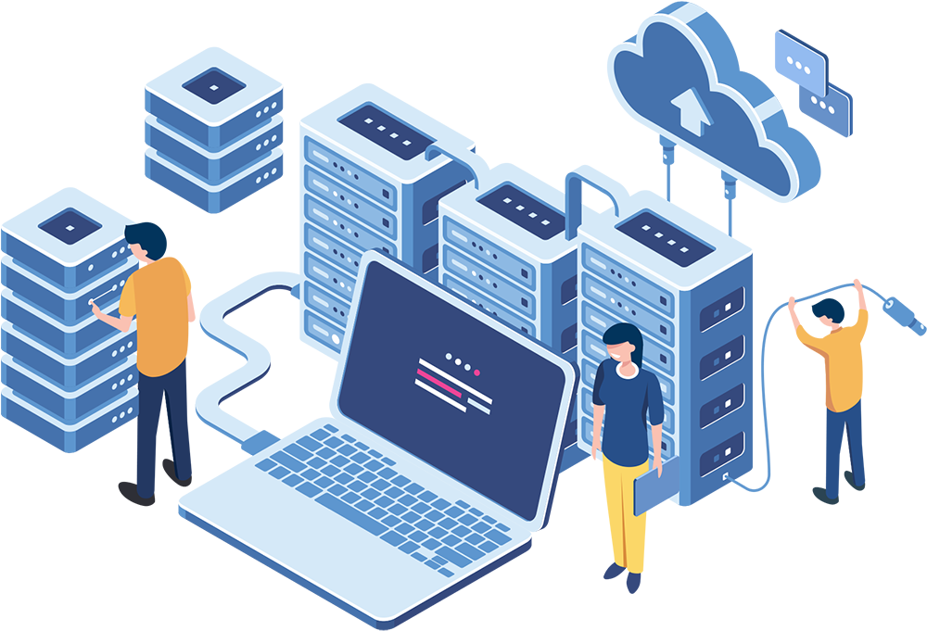
Streamlining Software Development: An Introduction to DevOps
What is DevOps?
Development
Operation
Notes:
Currently some organizations have two teams like the development and operation team.
development team kay mao ni sila ang mga devs like me hahahaha. they are the one who will integrate what client needs.
meanwhile ang IT operation teams are responsible for defining the way an organization manages software and hardware. and role ani nila kay tech management, quality assurance, and infrastructure management. in short, they are the one who will check and confirm if the final product meets customer’s need and expectations.
Sometimes or before nag adapt silage devops, one engineer can do both. Without devops, its very time consuming for the engineer to maintain both processes. ga develop pa sya at the same time ga monitor pajud sya sa quality sa project.
So the best solution for this is to use DevOps and why should we implement devops?

Slide 10

Code
Deploy
Plan
Release
Build
Operate
Development
Operation
Test
Monitor
Notes:
Currently some organizations have two teams like the development and operation team.
development team kay mao ni sila ang mga devs like me hahahaha. they are the one who will integrate what client needs.
meanwhile ang IT operation teams are responsible for defining the way an organization manages software and hardware. and role ani nila kay tech management, quality assurance, and infrastructure management. in short, they are the one who will check and confirm if the final product meets customer’s need and expectations.
Sometimes or before nag adapt silage devops, one engineer can do both. Without devops, its very time consuming for the engineer to maintain both processes. ga develop pa sya at the same time ga monitor pajud sya sa quality sa project.
So the best solution for this is to use DevOps and why should we implement devops?
NEXT

Slide 11

Code
Deploy
Plan
Release
Build
Operate
Monitor
Test
Notes:
Thinking about operations early on the development cycle ensures the software is designed and developed with operations consideration in mind, such as scalability, security, performance and monitoring.

Slide 12

Code
Deploy
Plan
Release
Build
Operate
Monitor
Test
Notes:
Thinking about operations early on the development cycle ensures the software is designed and developed with operations consideration in mind, such as scalability, security, performance and monitoring.

Slide 13

Code
Deploy
Plan
Release
Build
Operate
Monitor
Test
Notes:
Thinking about operations early on the development cycle ensures the software is designed and developed with operations consideration in mind, such as scalability, security, performance and monitoring.

Slide 14

Code
Deploy
Plan
Release
Build
Operate
Monitor
Test
Notes:
Thinking about operations early on the development cycle ensures the software is designed and developed with operations consideration in mind, such as scalability, security, performance and monitoring.

Slide 15

Code
Deploy
Plan
Release
Build
Operate
Monitor
Test
Notes:
Thinking about operations early on the development cycle ensures the software is designed and developed with operations consideration in mind, such as scalability, security, performance and monitoring.

Slide 16
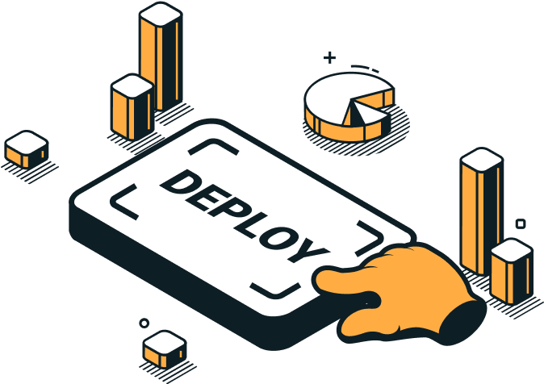
Code
Deploy
Plan
Release
Build
Operate
Monitor
Test
Notes:
Thinking about operations early on the development cycle ensures the software is designed and developed with operations consideration in mind, such as scalability, security, performance and monitoring.

Slide 17
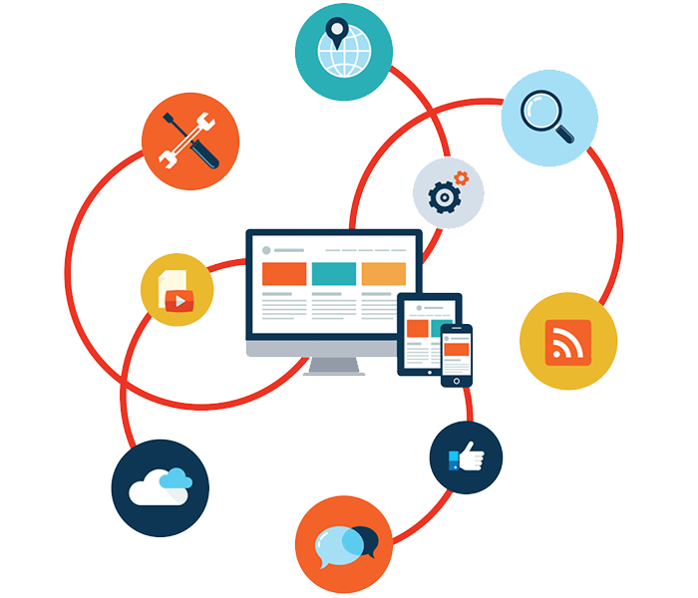
Code
Deploy
Plan
Release
Build
Operate
Monitor
Test
Notes:
Thinking about operations early on the development cycle ensures the software is designed and developed with operations consideration in mind, such as scalability, security, performance and monitoring.

Slide 18

Code
Deploy
Plan
Release
Build
Operate
Monitor
Test
Notes:
Thinking about operations early on the development cycle ensures the software is designed and developed with operations consideration in mind, such as scalability, security, performance and monitoring.

Slide 19
Code
Deploy
Plan
Release
Build
Operate
Monitor
Test
Notes:
Thinking about operations early on the development cycle ensures the software is designed and developed with operations consideration in mind, such as scalability, security, performance and monitoring.

Slide 20
Code
Deploy
Plan
CI
Release
CD
Build
Operate
Test
Monitor
Notes:
So I’ll be talking about devops tools. A DevOps toolchain is a set or combination of tools that aid in the delivery, development, and management of software applications throughout the systems development life cycle, as coordinated by an organization that uses DevOps practices. These are the few examples of devops tools.
Azure Devops
Aws
JIRA
Jenkins
Dockers and many more
Types of devops tools
Open source
Free
Freemium
Paid
Enterprise
Source Control
Database Automation
Continuous Integrtion
Testing
Configuration
Deployment
Containers
Release Orchestration
Cloud AIOps
Analytics
Monitoring
Security
Collaboration

Slide 21











Code
Deploy
Plan
CI
Release
CD
Build
Operate
Test
Monitor
Notes:
So I’ll be talking about devops tools. A DevOps toolchain is a set or combination of tools that aid in the delivery, development, and management of software applications throughout the systems development life cycle, as coordinated by an organization that uses DevOps practices. These are the few examples of devops tools.
Azure Devops
Aws
JIRA
Jenkins
Dockers and many more
Types of devops tools
Open source
Free
Freemium
Paid
Enterprise
Source Control
Database Automation
Continuous Integrtion
Testing
Configuration
Deployment
Containers
Release Orchestration
Cloud AIOps
Analytics
Monitoring
Security
Collaboration

Slide 22
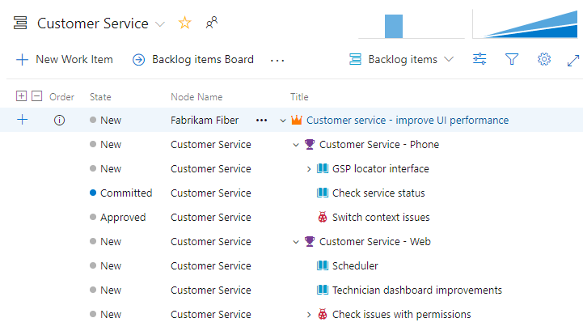
Notes:
So let’s take Azure Devops as an example for my presentation. Currently in my project we are using Azure Devops to manage and control client’s source code and project. so far I can say it’s easy to use kay It has everything we needed. Like this one.
For example Kanban board. Kanban boards visually depict work at various stages of a process using cards to represent work items and columns to represent each stage of the process.
build and release agent
The build agent is the machine that will do the work of the build pipeline. In this section, we will set up a custom (also called self-hosted) Azure DevOps build agent.

Slide 23
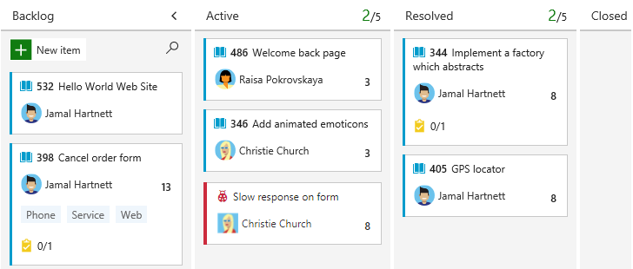
Notes:
So let’s take Azure Devops as an example for my presentation. Currently in my project we are using Azure Devops to manage and control client’s source code and project. so far I can say it’s easy to use kay It has everything we needed. Like this one.
For example Kanban board. Kanban boards visually depict work at various stages of a process using cards to represent work items and columns to represent each stage of the process.
build and release agent
The build agent is the machine that will do the work of the build pipeline. In this section, we will set up a custom (also called self-hosted) Azure DevOps build agent.

Slide 24
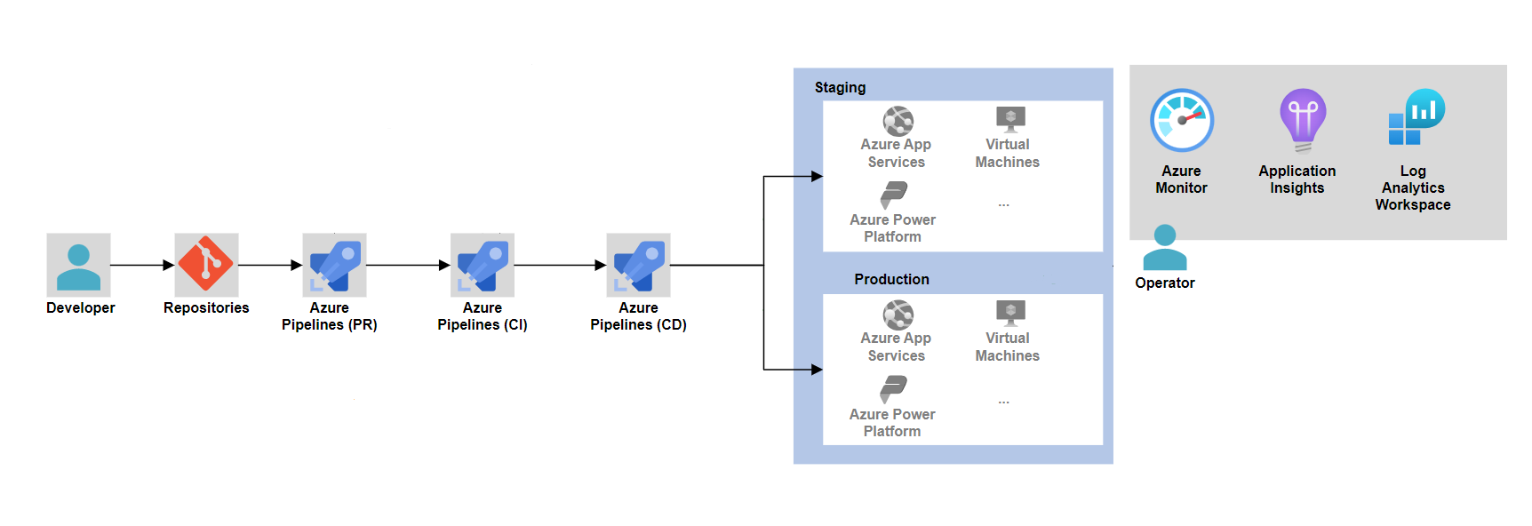
Notes:
Demo ci/cd workflow
A pipeline defines the continuous integration and deployment process for your app. It's made up of one or more stages. It can be thought of as a workflow that defines how your test, build, and deployment steps are run.
For Classic pipelines, a pipeline can also be referred to as a definition.

Slide 25
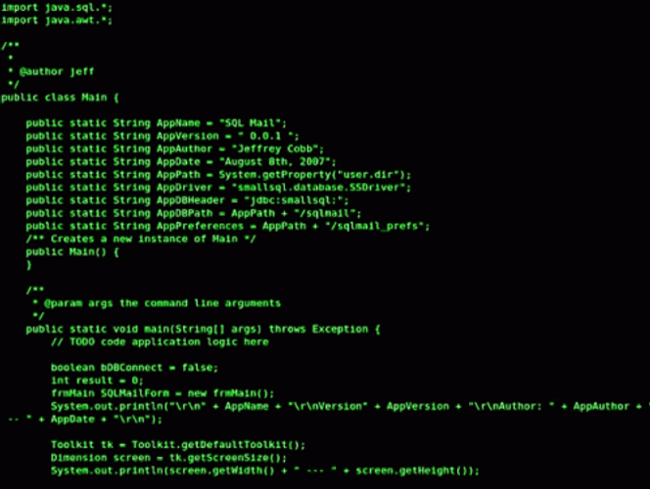

Git Commit & Git Push
Notes:
Git commit and push padung sa imong local branch ang feature na imong gi add

Slide 26
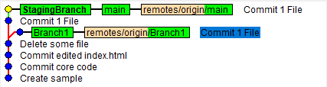

Slide 27
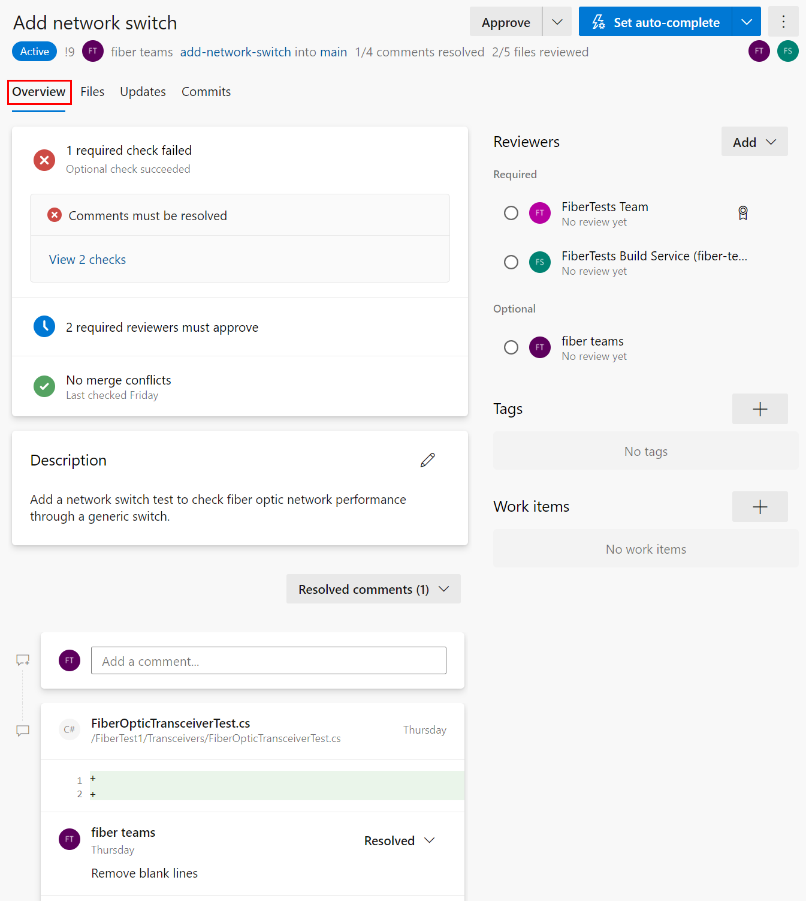
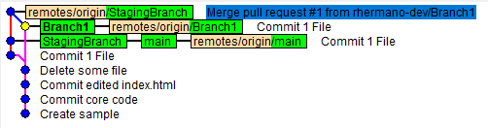

Slide 28
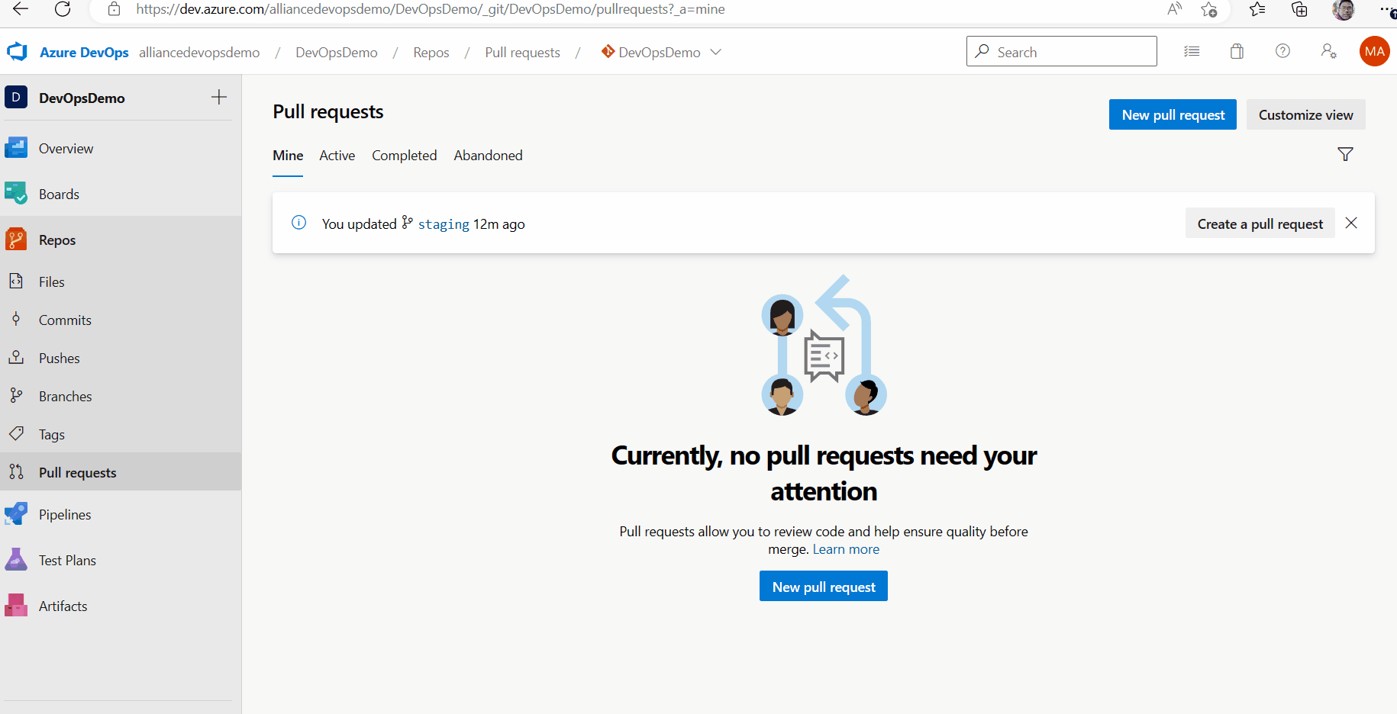

Slide 29
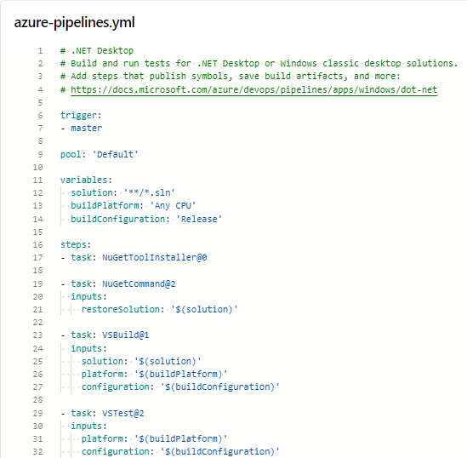
Notes:
CI
Continuous integration (CI) is the practice used by development teams to simplify the testing and building of code. CI helps to catch bugs or problems early in the development cycle, which makes them easier and faster to fix. Automated tests and builds are run as part of the CI process. The process can run on a set schedule, whenever code is pushed, or both. Items known as artifacts are produced from CI systems. They're used by the continuous delivery release pipelines to drive automatic deployments.
A trigger is something that's set up to tell the pipeline when to run.
- Code Analysis
- Restore
- Build
- Unit tests
- Publish build

Slide 30
Notes:
A step is the smallest building block of a pipeline. For example, a pipeline might consist of build and test steps. A step can either be a script or a task. A task is simply a pre-created script offered as a convenience to you. To view the available tasks, see the Build and release tasks reference. For information on creating custom tasks, see Create a custom task.
CI
- Code Analysis
- Restore
- Build
- Unit tests
- Publish build

Slide 31
Notes:
A task is the building block for defining automation in a pipeline. A task is packaged script or procedure that has been abstracted with a set of inputs.
CI
- Code Analysis
- Restore
- Build
- Unit tests
- Publish build

Slide 32
Notes:
CI
- Code Analysis
- Restore
- Build
- Unit tests
- Publish build

Slide 33
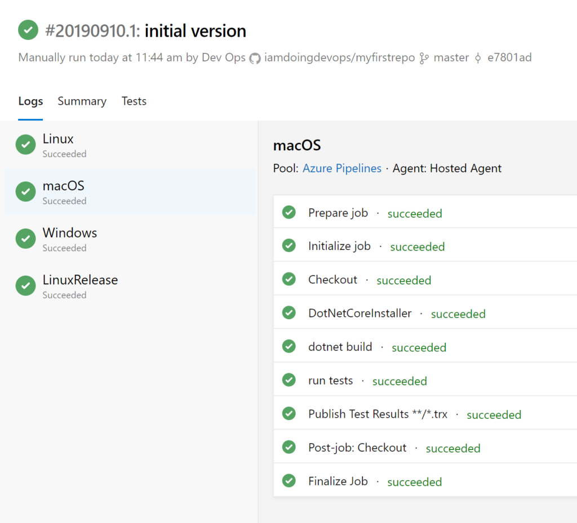
Notes:
CI
- Code Analysis
- Restore
- Build
- Unit tests
- Publish build

Slide 34
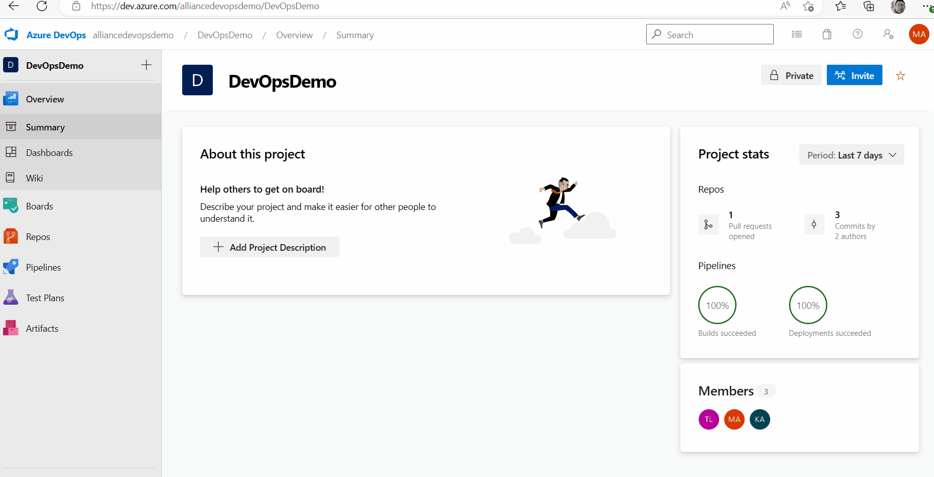
Notes:
CI
- Code Analysis
- Restore
- Build
- Unit tests
- Publish build

Slide 35
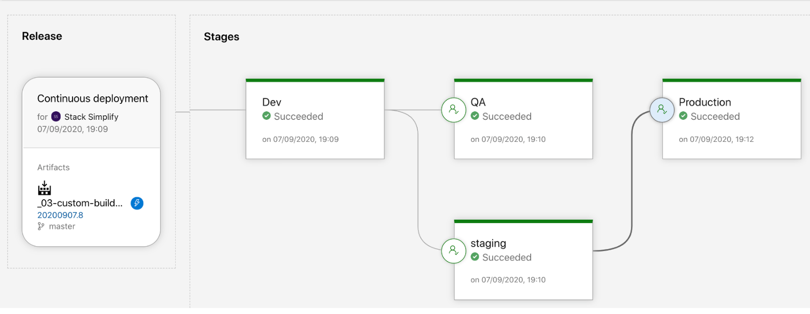
Notes:
CD
Continuous delivery (CD) is a process by which code is built, tested, and deployed to one or more test and production stages. Deploying and testing in multiple stages helps drive quality. Continuous integration systems produce deployable artifacts, which include infrastructure and apps. Automated release pipelines consume these artifacts to release new versions and fixes to existing systems. Monitoring and alerting systems run constantly to drive visibility into the entire CD process. This process ensures that errors are caught often and early.
- Deploy to staging
- Acceptance tests
- Release

Slide 36
Notes:
CD
Continuous delivery (CD) is a process by which code is built, tested, and deployed to one or more test and production stages. Deploying and testing in multiple stages helps drive quality. Continuous integration systems produce deployable artifacts, which include infrastructure and apps. Automated release pipelines consume these artifacts to release new versions and fixes to existing systems. Monitoring and alerting systems run constantly to drive visibility into the entire CD process. This process ensures that errors are caught often and early.
- Deploy to staging
- Acceptance tests
- Release

Slide 37
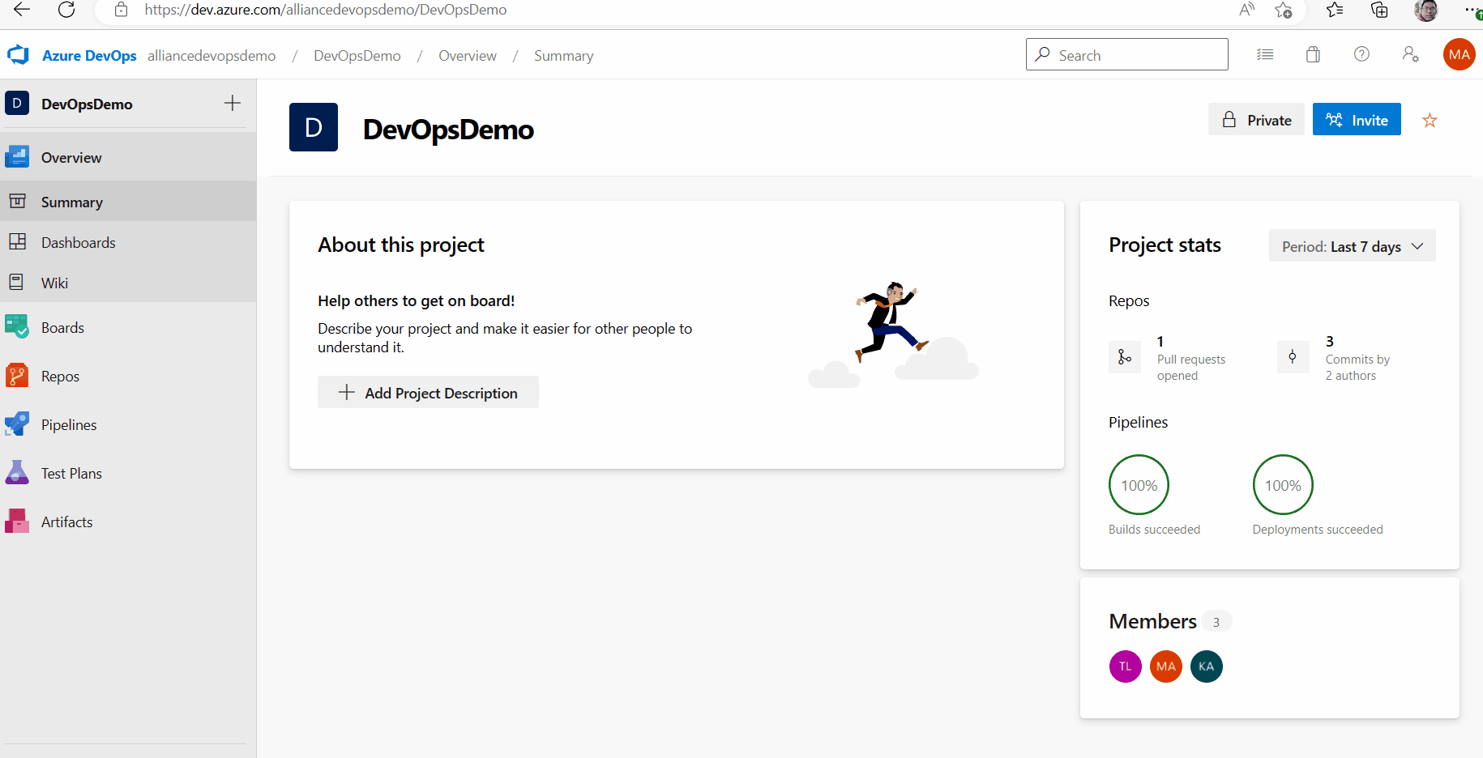
Notes:
CD
Continuous delivery (CD) is a process by which code is built, tested, and deployed to one or more test and production stages. Deploying and testing in multiple stages helps drive quality. Continuous integration systems produce deployable artifacts, which include infrastructure and apps. Automated release pipelines consume these artifacts to release new versions and fixes to existing systems. Monitoring and alerting systems run constantly to drive visibility into the entire CD process. This process ensures that errors are caught often and early.
- Deploy to staging
- Acceptance tests
- Release

Slide 42



Slide 43
Reynaldo A. Hermano III
rhermano@asi-dev5.com
www.rhermano.com
www.alliance.com.ph

